Slide 1
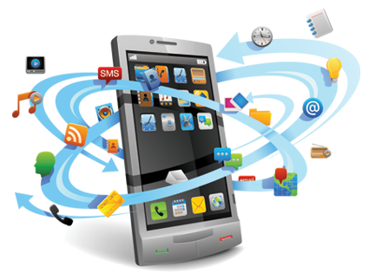

SECURITY IN MOBILE COMPUTING
Topic 6

Slide 2
Device Security

Slide 3
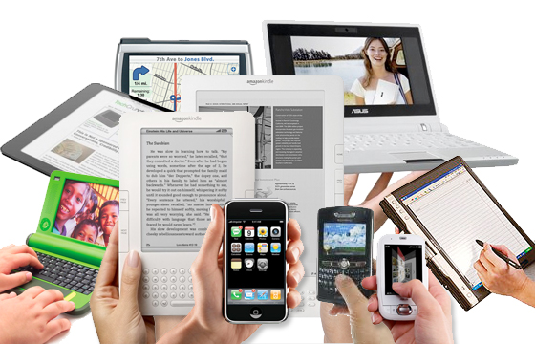
Mobile Devices
Modern mobile devices have evolved significantly
Impact on users
People using mobile devices like never before
Banking, shopping, email, social networking, etc.

Slide 4
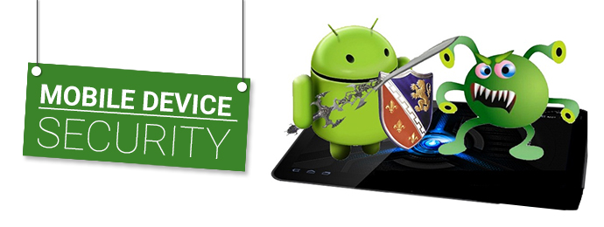
Mobile Devices
Impact on security
Sensitive data now being stored/input on devices
Economic incentive for attackers is growing

Slide 5
Security in Mobile Computing
Mobile devices make attractive targets:
Wireless communication snooping/security issues
People store much personal info on them: email, calendars, contacts, pictures, etc.
Can fit in pockets, easily lost/stolen
Built-in billing system: SMS/MMS (mobile operator), in-app purchases (credit card), etc.
Many new devices have near field communications (NFC), used for contactless payments, etc.
Device becomes credit card
Location privacy issues

Slide 6
Mobile Malware

Slide 7
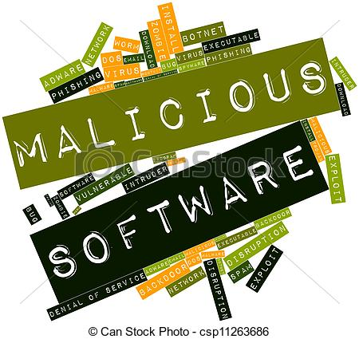
What is Malware?
Malicious Software
Malicious code - is a software program that generates threats to the computers and data stored on it.

Slide 8
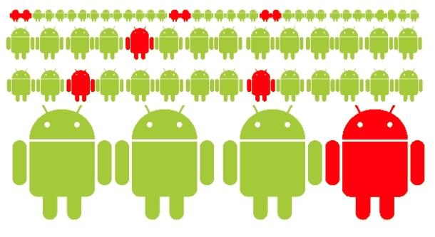
Mobile Device Malware
Mobile device has become a breeding ground for Malware.
These malware can be used or manipulated to harvest personal identifiable data.
Some malware are used to propagate unsolicited advertisement

Slide 9
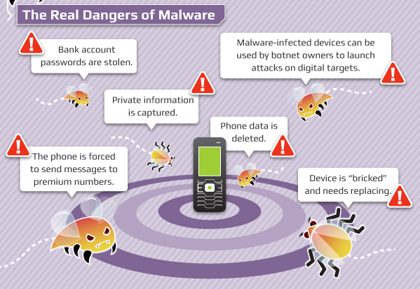

Slide 10
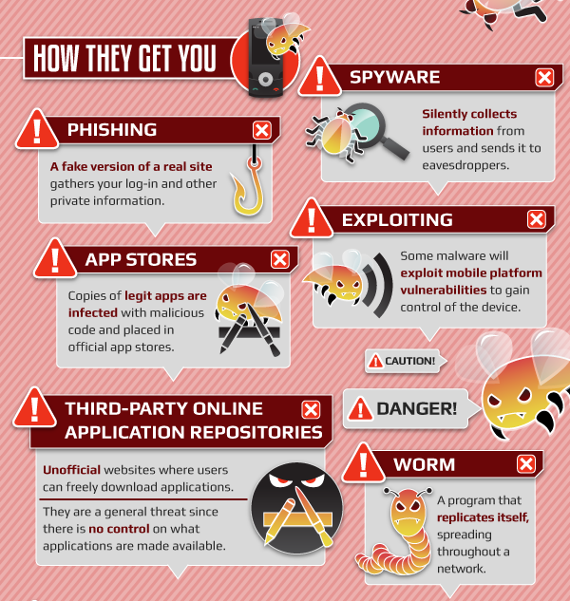
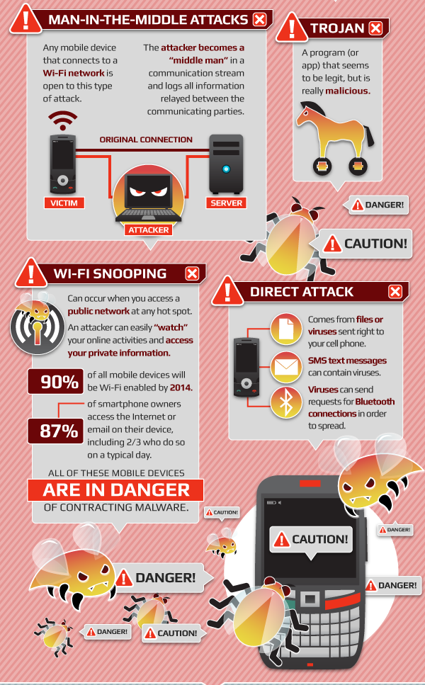

Slide 11
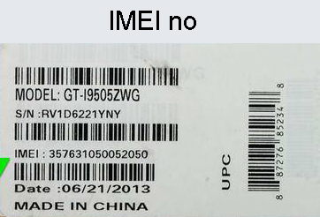
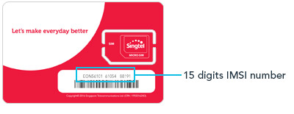
Personally Identifiable Information
“Personally Identifiable Information” is information that can be used to isolate users or identify users based on several factors.
Common Information that can be used to personally identify users are:
Email address
MAC address
IMEI number (phone serial number)
IMSI number (cellular identification number)
Bluetooth Address
Phone Number

Slide 12
Personally Identifiable Information
The use of this information is EXTREMELY sensitive!
BE AWARE of application that request access to these information as they could be possibly used to personally identify users
Use of these information might
compromise privacy
track every users movement and financial transactions
Do not install application the request excessive permission to access these information.

Slide 13
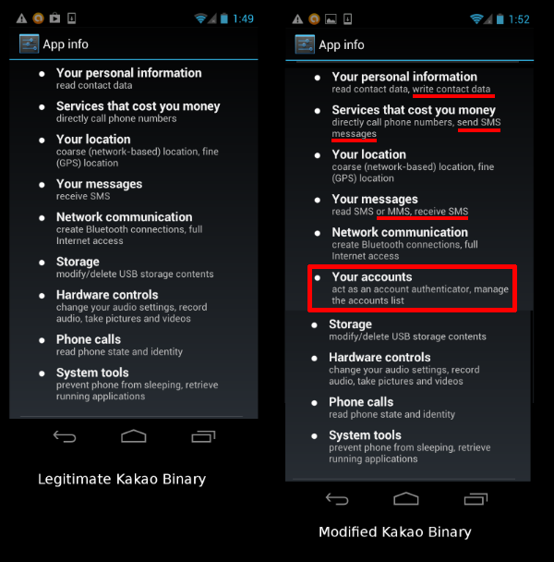
Example Malware

Slide 14
Best Practices to Avoid Malwares
Only install application from reputable and trusted sources (iOS App Store, Google Play, Windows Store)
Avoid installing application from 3rd party websites (eg: APK Installer, *.exe)
Ensure the application installed are produced by the “official publisher”
Avoid granting excessive or unnecessary permission to application

Slide 15
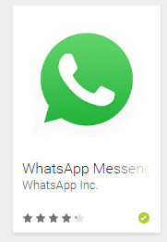
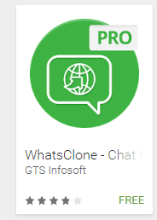
Official Publisher vs Unofficial Publisher
Be wary of unofficial publisher as your data might pass through a 3rd party server

Slide 16
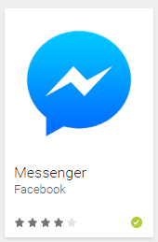
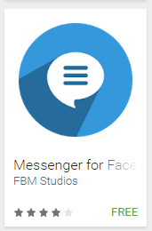
Official Publisher vs Unofficial Publisher
Be wary of unofficial publisher as your data might pass through a 3rd party server

Slide 17
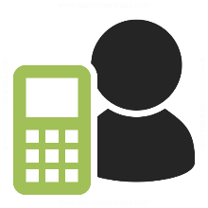
Normal Communication using Official Application
Connects directly to middleware and Application Server from mobile application
Application Server
Middleware
Internet
Application Server
Application Server

Slide 18

Communication using unofficial Application
Application Server
Middleware
3rd Party Proxy
Internet
Application Server
Connection may gone through proxy controlled by malicious 3rd party
Application Server
Malicious 3rd party

Slide 19
Wireless Connection Security

Slide 20
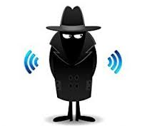
Security Issues in Wireless Network
Unlike wired network, wireless network communication are broadcasted.
This means that everybody with a receiving device can monitor all incoming and outgoing traffic if the signal is within the communication range
Therefore, the security and privacy issues within wireless network is very crucial when compared with wired network.

Slide 21
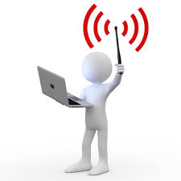
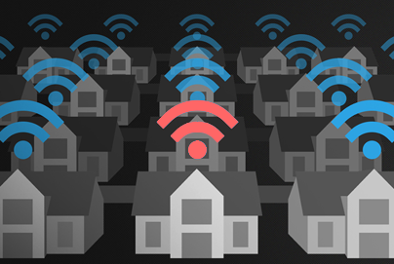
Securing WiFi connection
In the present day, WiFi connection is ubiquitous
However, improper WiFi configuration could compromise the security and the privacy of wireless communication
As most WiFi network is auto-configured, it is easy for anybody with malicious intention to masquerade as a legitimate

Slide 22
Securing Wireless Network (WiFi)
In order to ensure WiFi connection is secure:
Avoid connecting to open and unencrypted WiFi connection
Use stronger WPA encryption whenever connected to a WiFi network
Be wary when connecting to a public WiFi connection, sometimes malicious party intentionally set upa public WiFi for the sole purpose of harvesting sensitive information from unsuspecting users
Use a (Virtual Private Network) VPN service whenever possible
Connect to website that implements secure HTTPS connection with TLS and SSL only

Slide 23
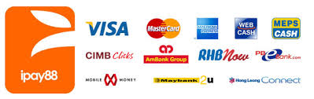
Securing Wireless Network (WiFi)
It is advisable that users do not access sensitive application (e.g Banking application) from public WiFi network
The public WiFi network may be used or set-up by hackers and designed to harvest user data and sensitive information

Slide 24
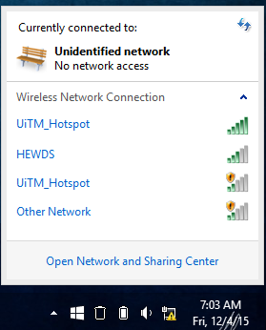
“Evil Twin” WiFi Attack
Which one do you choose to connect?

Slide 25
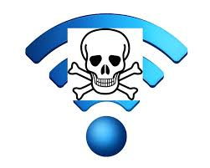
“Evil Twin” WiFi Attack
The ‘evil twin’ WiFi attack is also another popular method to gain access towards private user data
In this attack, the attacker would bring his own WiFi AP, and set the AP name to masquerade a legitimate WiFi to confuse users.
Users who connect to the attackers WiFi AP might be compromised

Slide 26
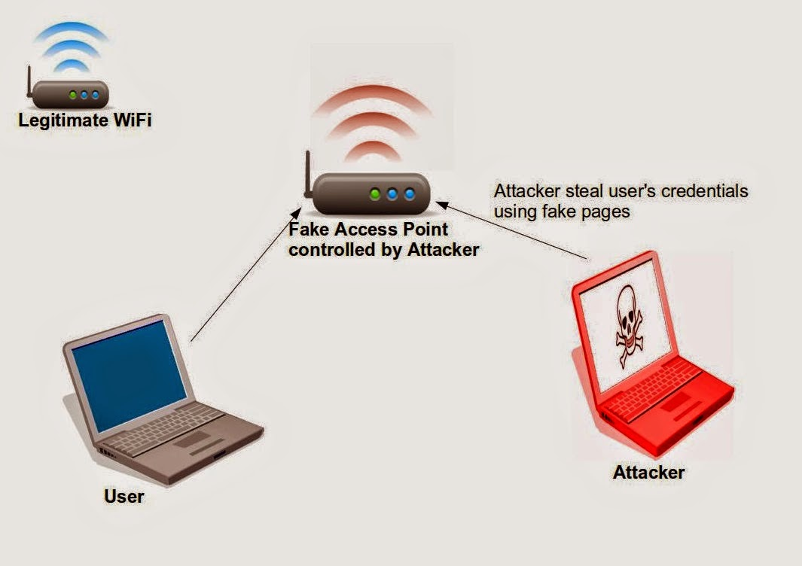

Slide 27
Authentication & Authorization

Slide 28
Access Control: Authentication and Authorization
There are two categories of access control:
Authentication
Determines the identity of the user
Allow legitimate user to use device or application
Require prove of authentication (password, unlock pattern, facial recognition)
Authorization
Second-level access control
Determine what the user can do or cannot do

Slide 29
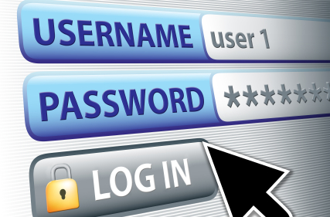
Password Authentication
Advantages:
Cheapest, easiest form of authentication
Works well with most applications
Drawbacks: Also the weakest form of access control
Lazy users’ passwords: 1234, password, letmein, etc.
Can be defeated using dictionary, brute force attacks

Slide 30
Password Authentication
Requires administrative controls to be effective
Minimum length/complexity
Password aging
Limit failed attempts

Slide 31
Biometrics
Biometric-based authentication – our own body becomes the key and can be used for access control.
Helps to improve complexity of the access control system.
Measures and analyses a person’s unique characteristics and uses it for authentication.
The particular characteristics which is used for authentication is called biometric trait.
Physiological-based biometric trait
Behavioural-based biometric trait

Slide 32
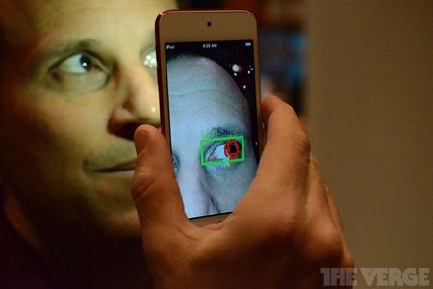
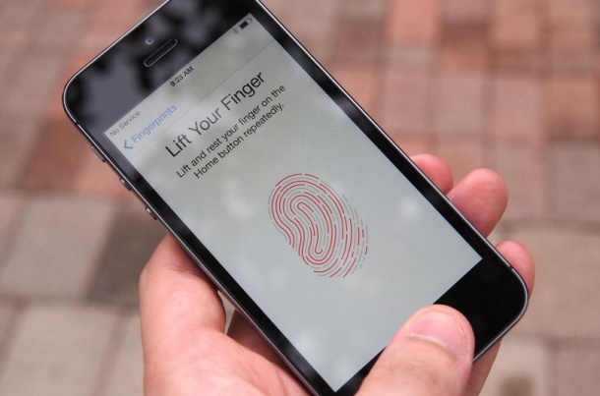
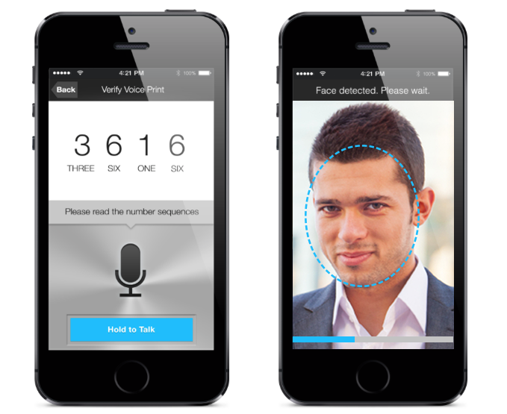
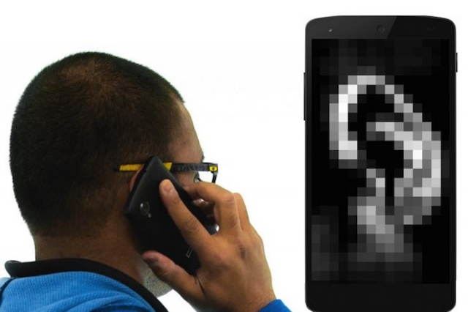
Physiological-based biometric trait
Fingerprint, Face, Iris or retina,

Slide 33
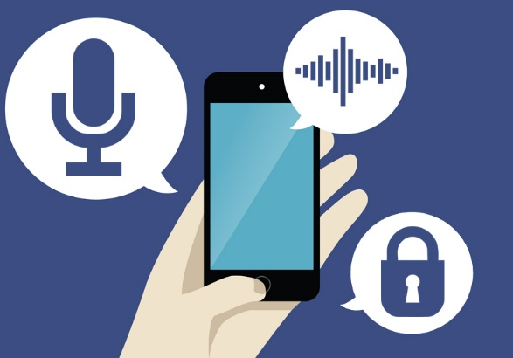
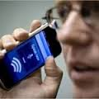
Behavioural-based biometric trait
Speech

Slide 34
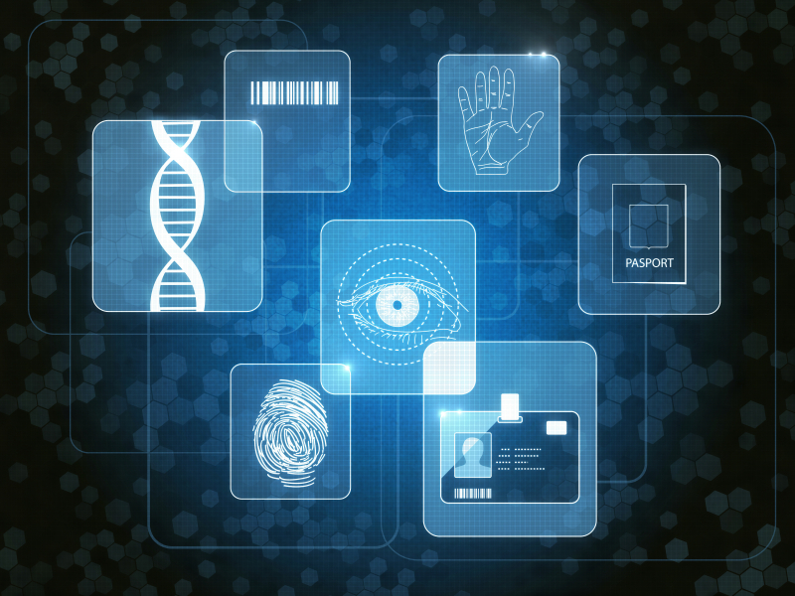
Advantages of Biometrics
Traits cannot be forgotten or misplaced and cannot be lost
More difficult to forge
Requires only the person to be present at the time.
Difficult to be cracked

Slide 35
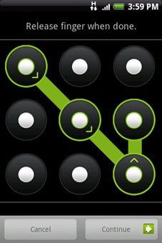
Authentication: Pattern Lock
Swipe path of length 4–9 on 3 x 3 grid
Easy to use, suitable for mobile devices
Advantage: 389,112 possible patterns; (456,976 possible patterns for 4-char case-insensitive alphabetic password!)
Drawbacks: Attacker can see pattern from finger oils on screen

Slide 36
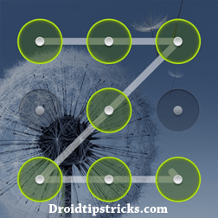
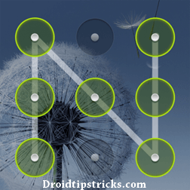
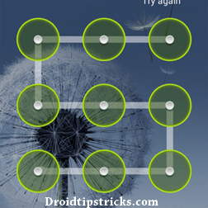
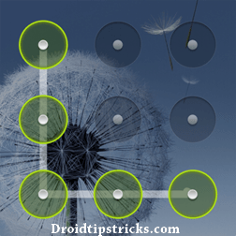
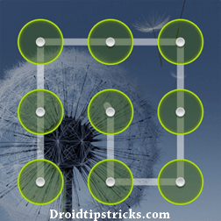
Most common patter lock

Slide 37
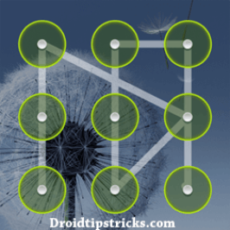
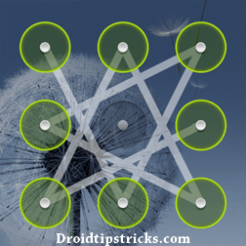
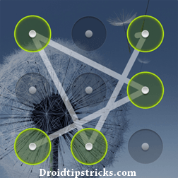
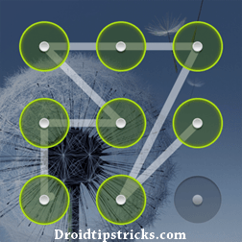
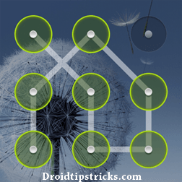
Hardest as well as Coolest pattern lock ideas

Slide 38
Authentication: Comparison
 | Password | Biometrics | Pattern Lock
Security | Weak | Strong | Weak
Ease of Use | Easy | Hard | Easy
Implementation | Easy | Hard | Easy
Works on phones | Yes | Possible | Yes
Which one is more secure?
Password OR Pattern Lock?
http://www.zdnet.com/article/dont-use-android-pattern-lock-to-protect-secrets-researchers-warn/
https://www.wired.com/story/android-unlock-pattern-or-pin/

